Slide 1
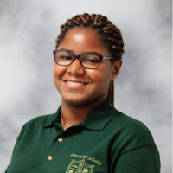

Netflix Bootcamp Capstone
Chloe Taylor and Zaid Abdul-Kaudeyr

Slide 2



Description
The goal of this project was to create a game store web service. The user would be able to decide between items that they would like to purchase such as games, consoles, or tshirts and receive an invoice based on the information that they entered. The invoice would contain the information they entered along with the amount they should pay.

Slide 3


Process
Technologies Used-
IntelliJ IDEA
Spring Boot
MySQL
Swagger Inspector
Pivotal Tracker
Git
Breakdown of Tasks-
Input the tables and data into the database
Create the Models, Daos, Controllers, Service Layer, JdbcTemplateImpl, and View Model
Create tests for everything in the program
Review and go over the finished code

Slide 4

Process (cont.)
Challenges-
Time constraints
Understanding how to use Tax and Processing Fees
Service Layer had many errors
Testing was very difficult for some parts
Successes-
Fixing the Invoice portion of the Service Layer
Models were completed with relatively little issues
Testing for the Daos

Slide 5
Demo

Slide 6

Directions For Future Development
Adding a Front End
Finding all errors and completely debugging the code
Using view models for all models and not just the invoice

Slide 7
Links
https://github.com/zaidabdulkaudeyr/Summative-3-Netflix-Java.git

